Slide 1
Core Data
Tutorial

Slide 2
Overview
Persist or cache data and support undo on a single device.
This document contains the followings on Core Data:
Modeling data using Xcode’s model editor.
Add new records to Core Data.
Fetch a set of records from Core Data.
Display the fetched records using a table view.

Slide 3
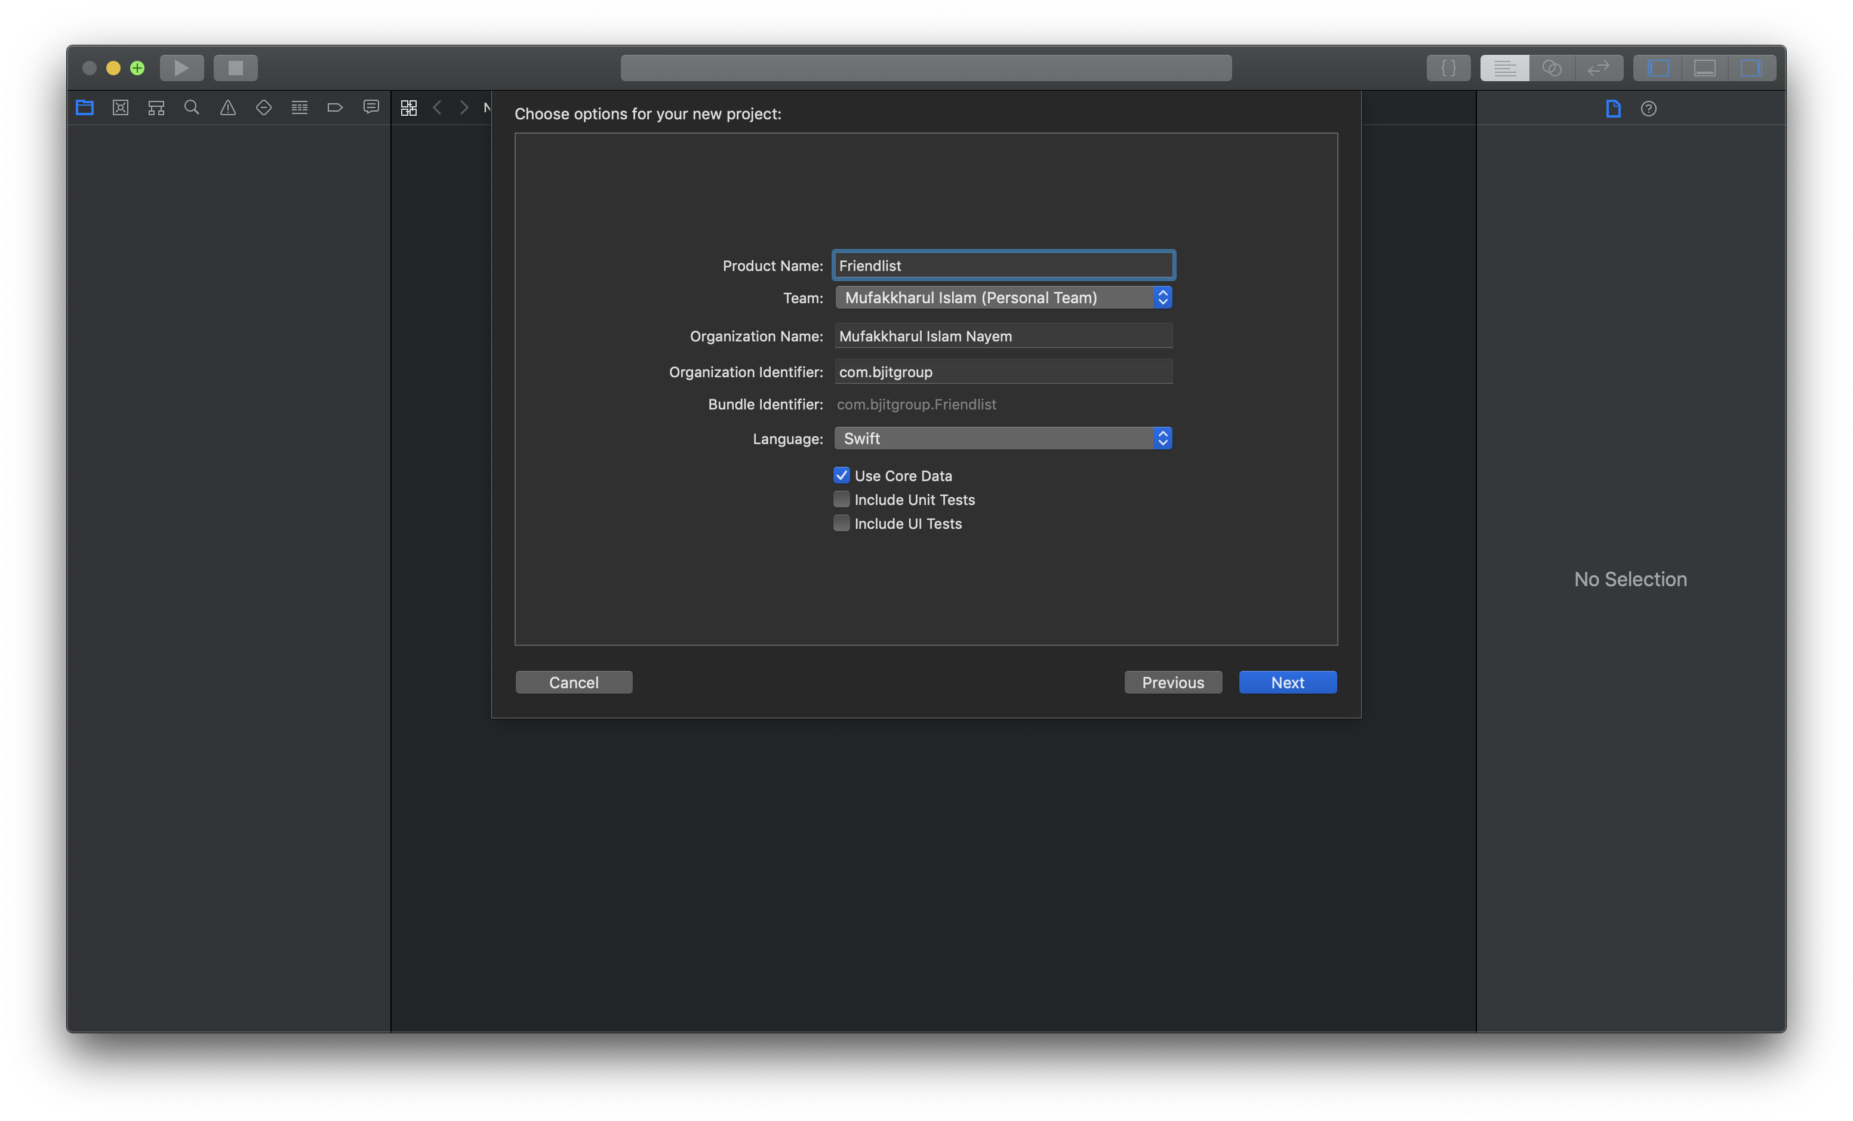
naming conventions
Enable Core Data for use in a project
At the time of the creation of the project:

Slide 4
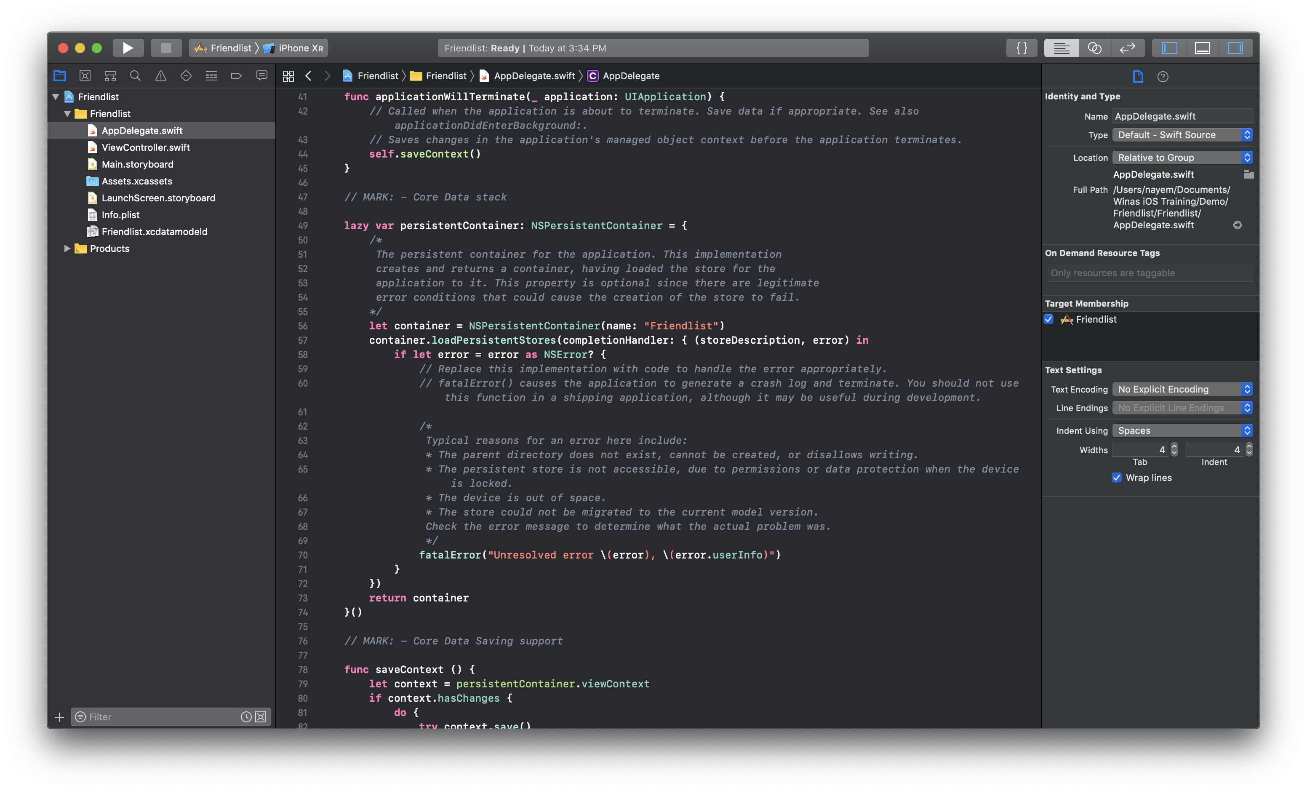
naming conventions
Enable Core Data for use in a project (cont.)
Xcode automatically adds some boilerplate code in AppDelegate and a .xcdatamodeld file in the project navigator.

Slide 5
naming conventions
Enable Core Data for use in a project (cont.)
But sometimes you need to add core data support in an already existing project.
How do we do that?
Actually, it’s not very different from what the automatic adoption did for us.
Add a new .xcdatamodeld to the project
Add those boilerplate code in AppDelegate (though this isn’t mandatory)
We will do that in practical.

Slide 6
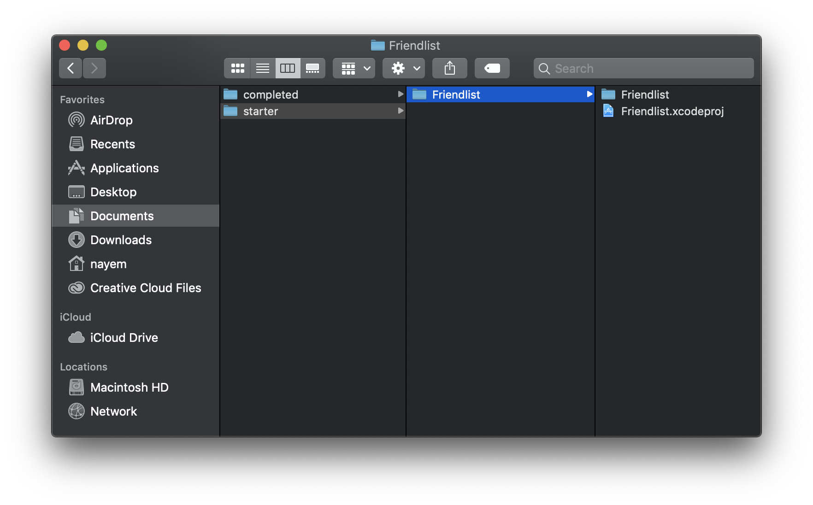
naming conventions
Enable Core Data for use in a project (cont.)
Open the demo project, Friendlist from the starter directory.
Run the project in a device/simulator. Add some names. Then clear the Friendlist app from the app switcher (this is known as force close/kill an app). After that, click the app to open again.
What?!! Where are the names that we just added before?
We will fix this.

Slide 7
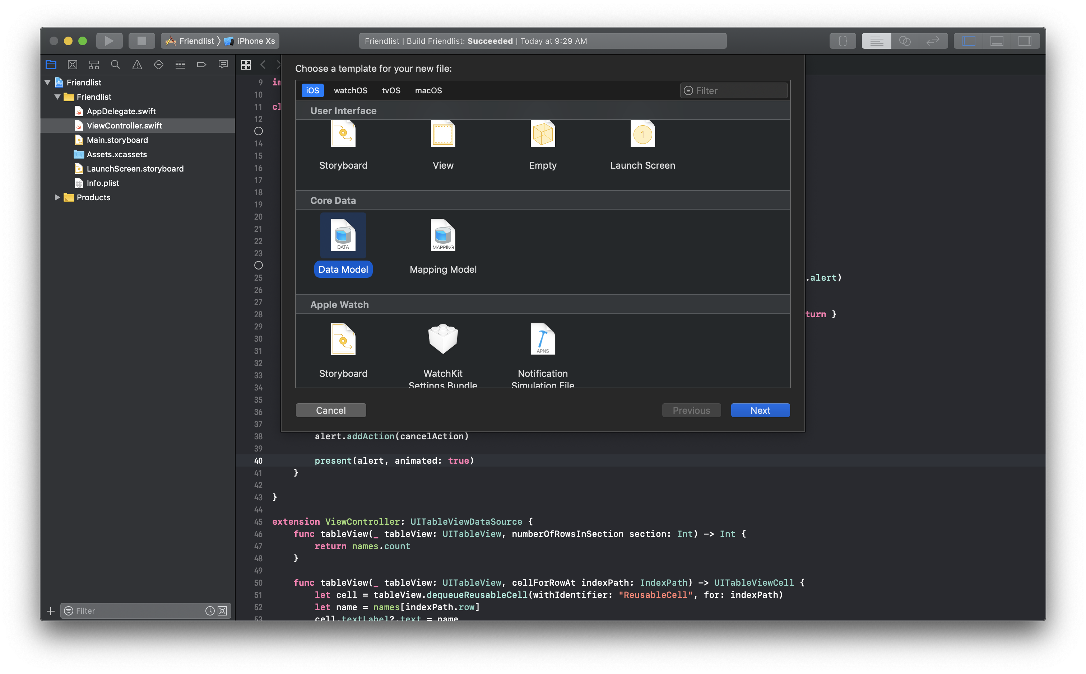
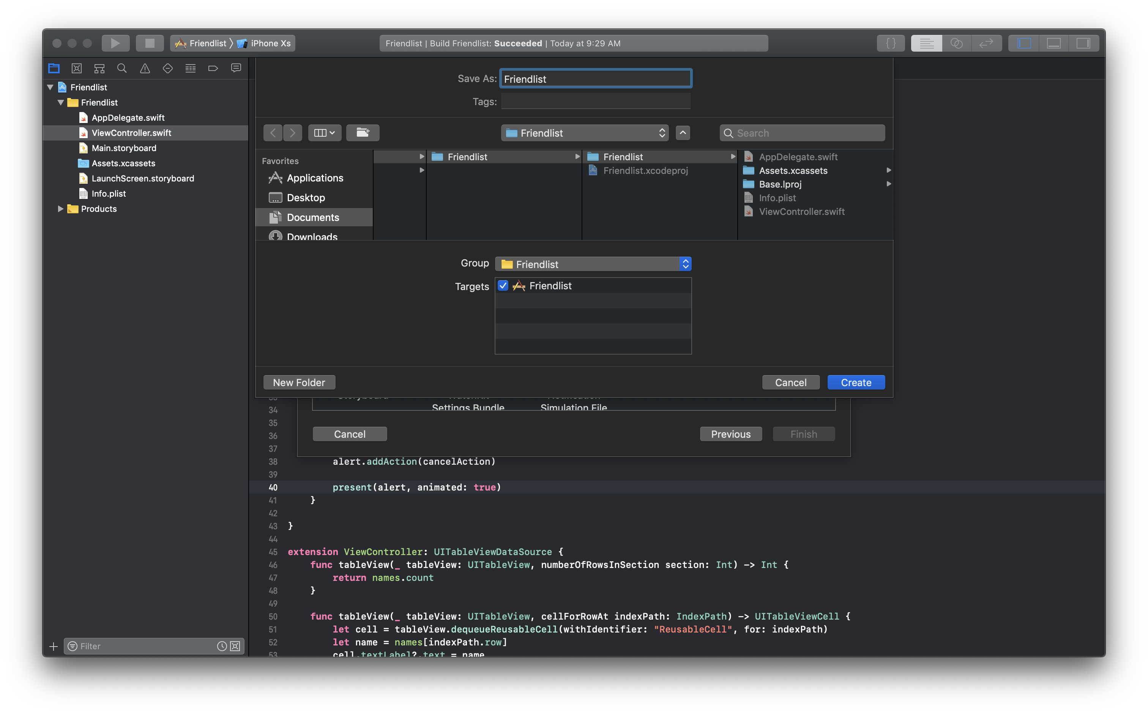
naming conventions
Enable Core Data for use in a project (cont.)
Add new file like below for Core Data. You can save the file name as you want. But it’s standard to use the same name as the project name.
After adding the core data model (.xcdatamodeld file) Xcode opens the file. Xcode has a rich data model editor.
You can explore a lot of features later on. For now, let’s focus on creating a single Core Data entity.

Slide 8
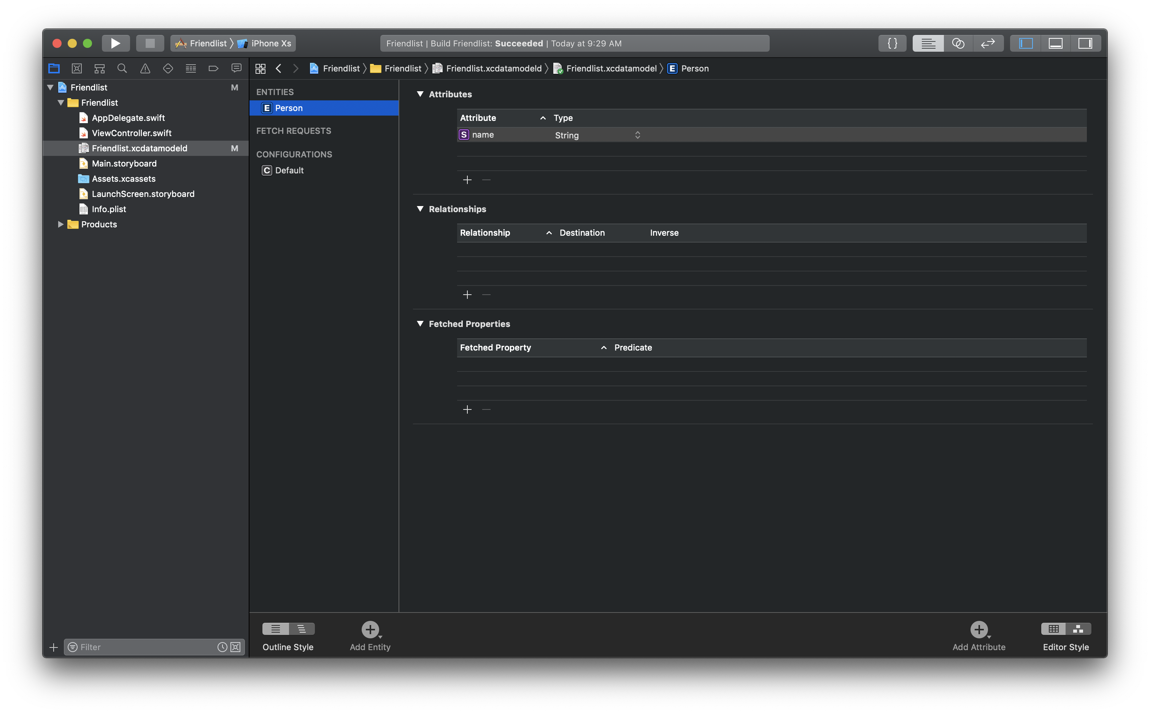
naming conventions
Enable Core Data for use in a project (cont.)
Click on Add Entity to create a new entity. Double-click the newly added Entity and change it’s name. Click on the + icon below the Attributes section and add an attribute name of type String.
You can obviously add as many attributes as you want. But for demonstration purpose, we are going to use only one attribute.

Slide 9
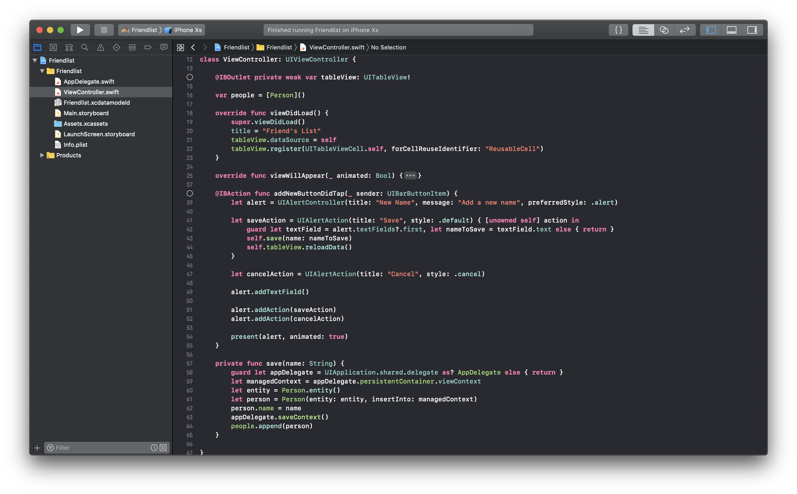
naming conventions
Enable Core Data for use in a project (cont.)
As of now, Core Data model is ready to be used.
We will use this model for saving and fetching Person type data.
Some code in the demo project needs to be modified in order to facilitate this Core Data model. Here is an overview:

Slide 10
naming conventions
Enable Core Data for use in a project (cont.)
Before proceeding for modification in the ViewController.swift file, we need to add those Boilerplate codes(refer to slide no. 4) in the AppDelegate for having Core Data support available to other places of the project.
The idea of adding those boilerplate codes in AppDelegate is: Using the same persistent object everywhere in the project.

Slide 11
naming conventions
Enable Core Data for use in a project (cont.)
Live demo

Slide 12
naming conventions
The End
Thank you.

